Slide 1


Infographic Templates for Professionals
Presented by [Your Name]

Slide 2
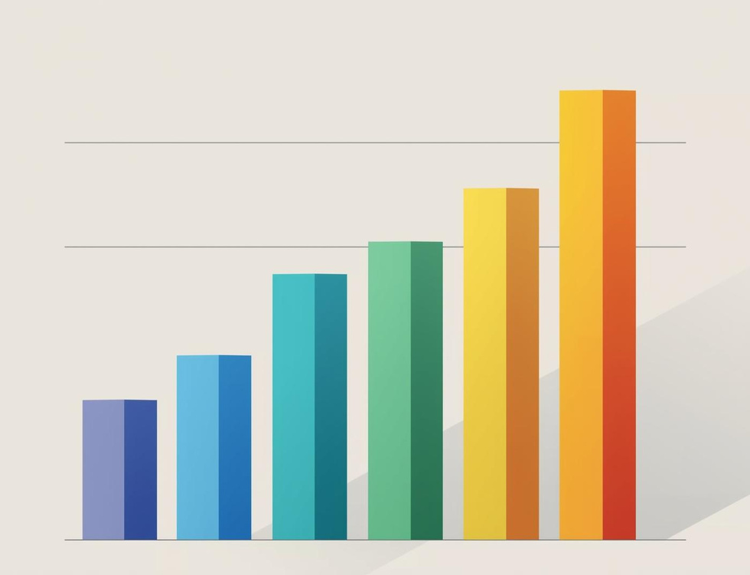
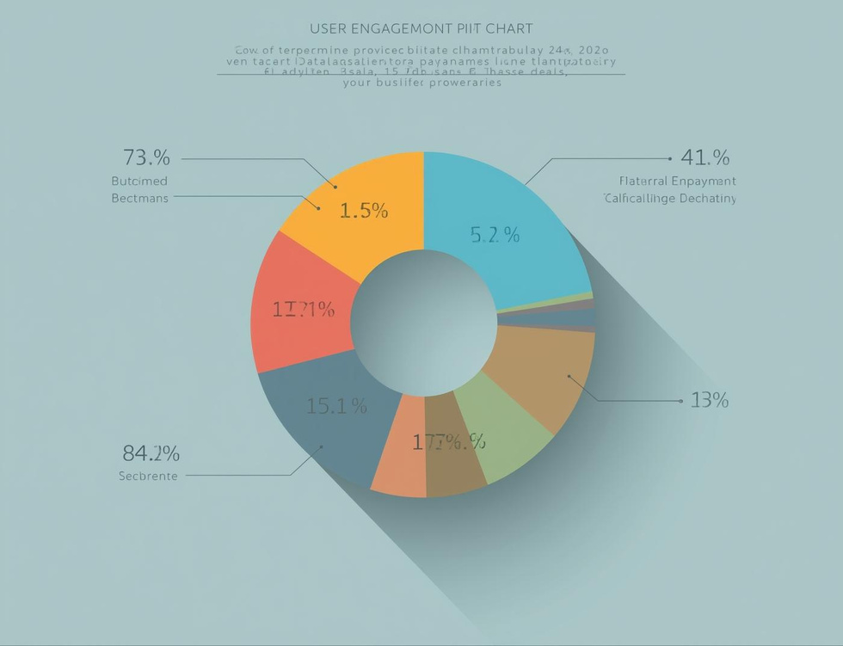

Key Metrics Overview
Metric Performance
User Engagement
Growth Rates
This metric highlights performance trends over the last quarter using bold visual representation.
User engagement metrics emphasize content interaction and audience reach for strategic insights.
This visual compares growth rates, illustrating significant progress and potential opportunities for expansion.

Slide 3
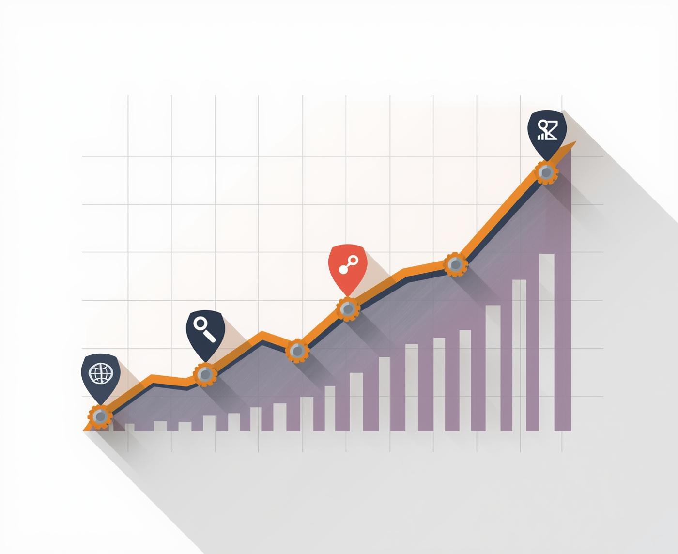

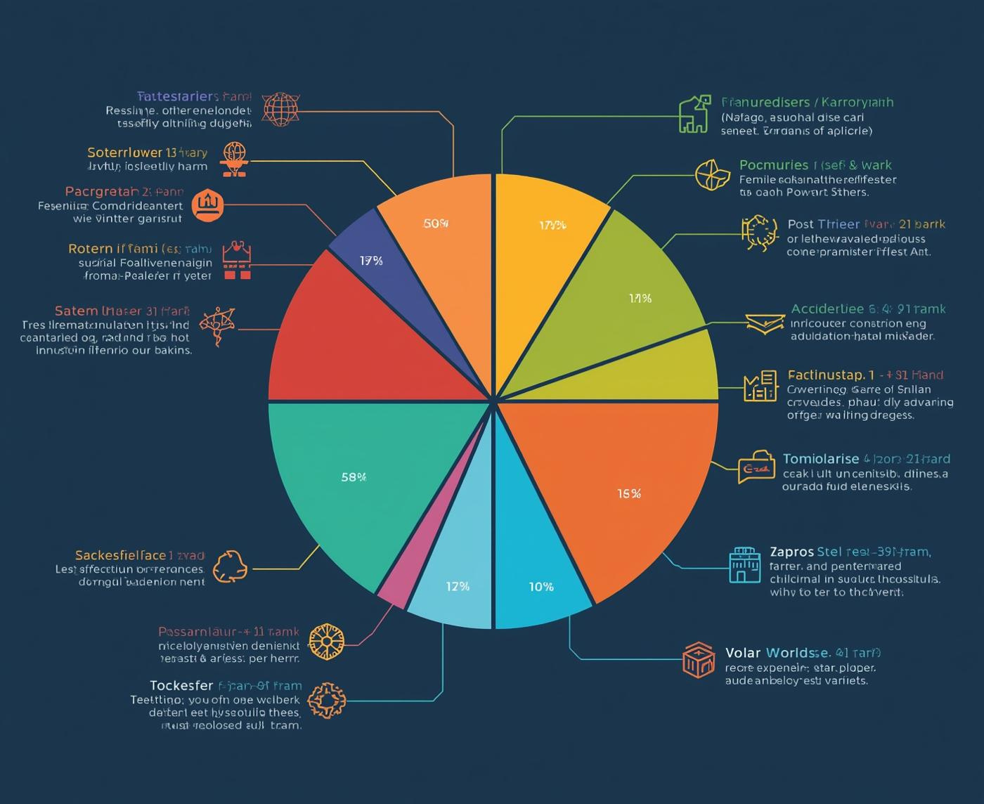
Expanded Charts and Trend Lines
Visualizing Key Metrics Effectively
This section highlights the importance of utilizing expanded charts and trend lines to present key metrics clearly and concisely for better decision-making and insights.
3

Slide 4

Summary Insights
Key Takeaways for Effective Infographics
Clarity Matters
Modular Flexibility
Visual Engagement
Using bold typography and clean layouts ensures that key metrics are easily understood, allowing for quick data digestion and effective communication during presentations.
Modular design allows users to rearrange components effortlessly, enabling the customization of presentations based on audience needs or specific data highlights without extensive redesign.
Incorporating geometric vector illustrations and consistent iconography enhances the visual appeal, making infographics not only informative but also engaging, fostering better retention of key information.
4

Slide 5
High-Level Process Overview
01
Step One
03
Step Three
Identify goals and objectives for the process.
Assign roles to team members for each step.
02
Step Two
04
Step Four
Map out the necessary steps to achieve goals.
Monitor progress regularly to ensure success.

Slide 6
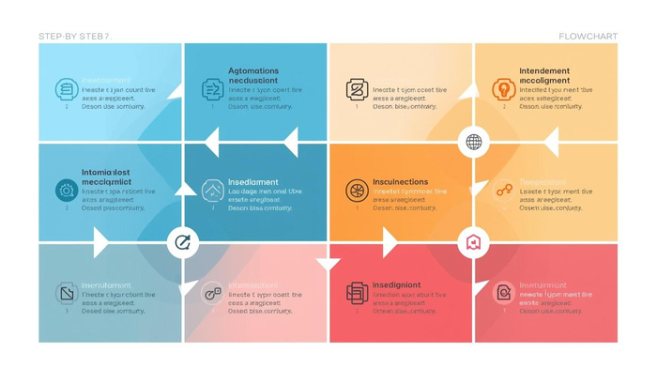
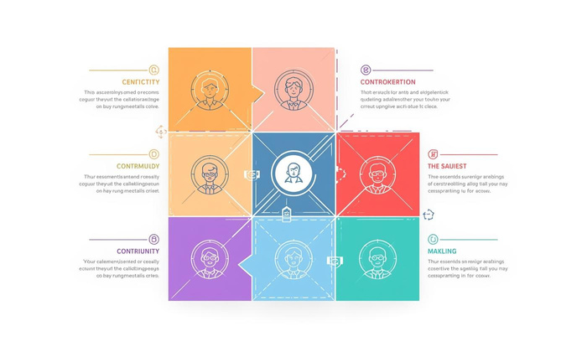
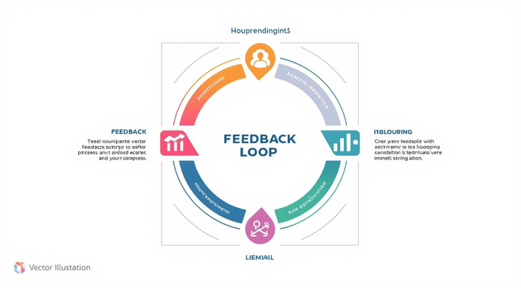

Detailed Explanation of Process Steps
Step One
Step Two
Initiating the process with clear objectives.
Implementing the necessary actions for progress.
Step Three
Completing the process and reviewing outcomes.

Slide 7
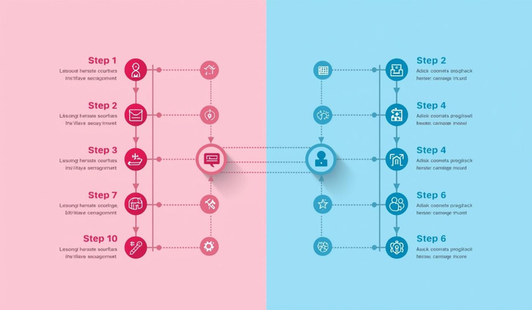
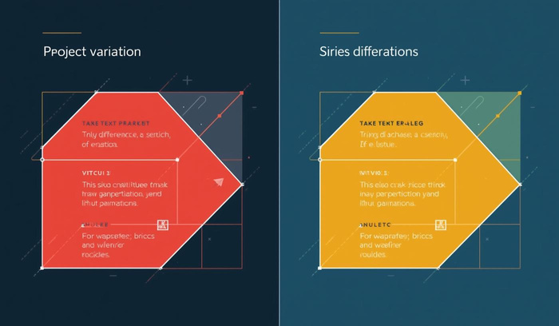
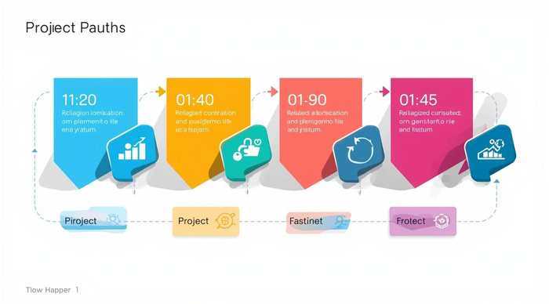
Variations and Parallel Workflows in Projects
Step Comparison
Process Efficiency
Visualizes differences between two workflows efficiently.
Highlights strengths and weaknesses in each approach.
Timeline Analysis
Compares project timelines for better planning decisions.

Slide 8

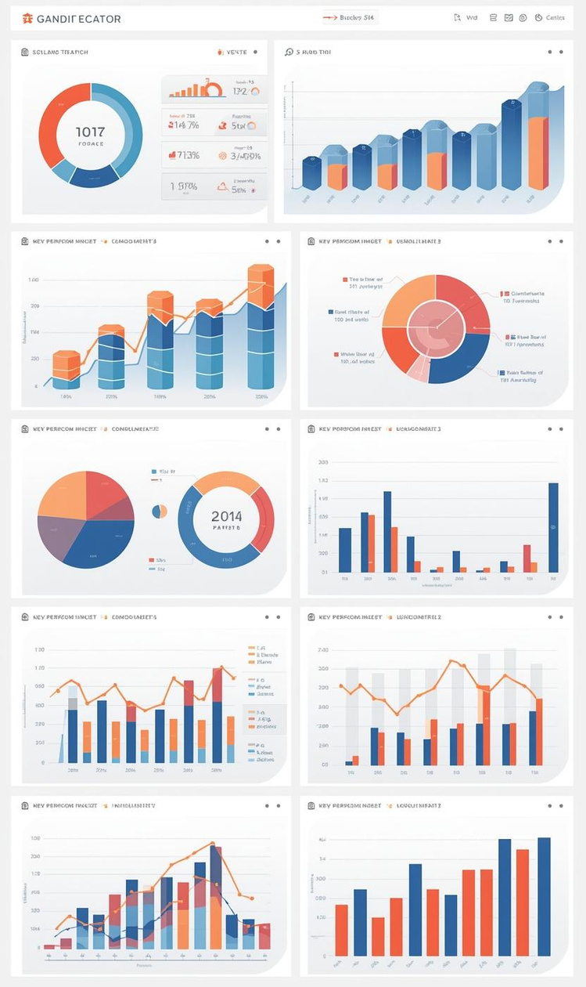
Comparison Overview of Key Metrics
Metric Analysis
Visual Comparison
Focus on essential KPIs for decision-making.
Utilize charts for clear data insights.

Slide 9

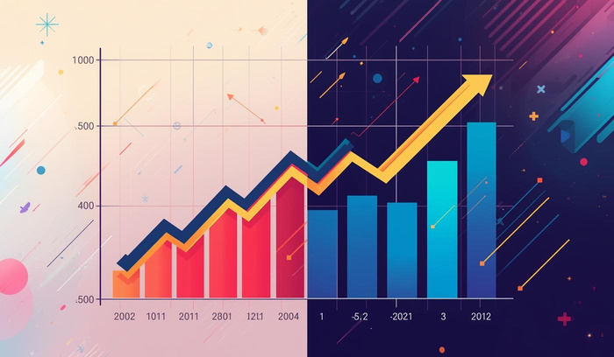


Detailed Feature and Metric Comparison
Feature A
Feature B
This feature enhances user experience significantly.
This feature optimizes processing efficiency and speed.
Feature C
Feature D
This feature provides insightful analytical capabilities.
This feature ensures data accuracy and reliability.

Slide 10
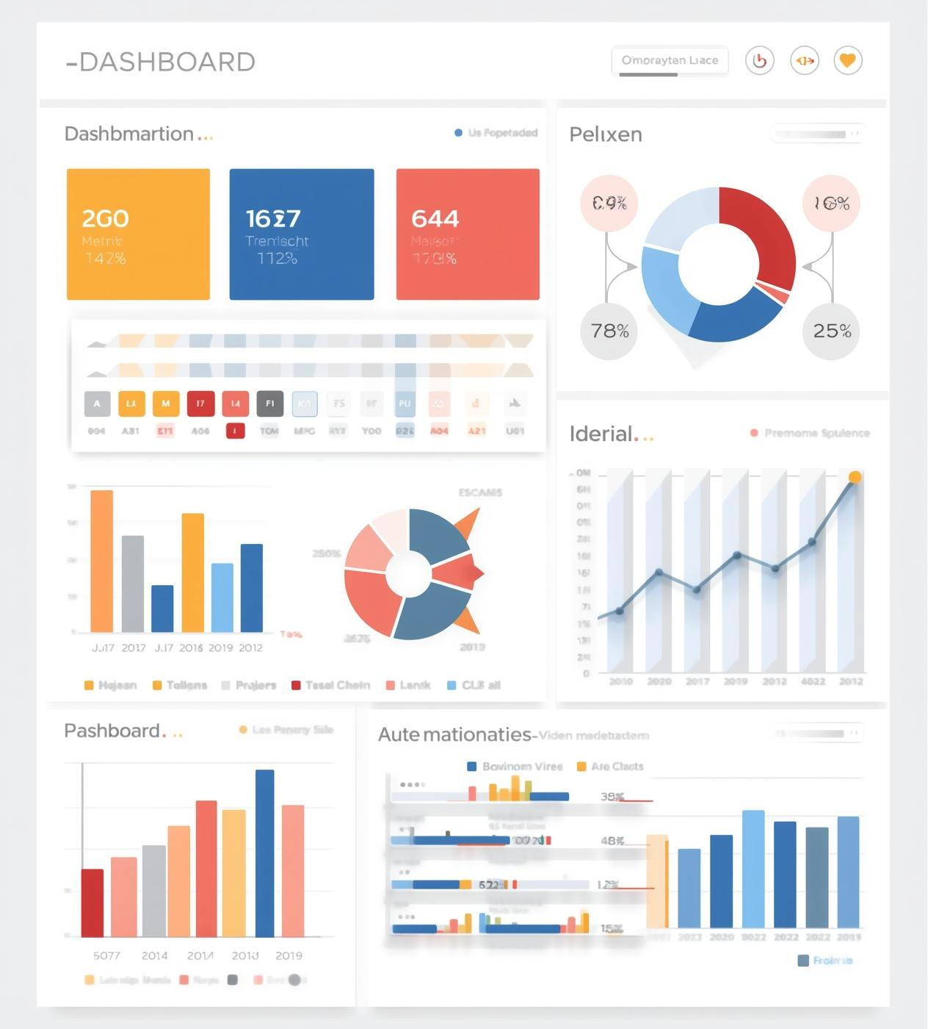
Summary Insights and Recommendations
This section provides key takeaways and actionable steps for leveraging data-driven insights, ensuring decision-makers can quickly grasp essential information and effectively implement strategies to drive organizational success.

Slide 11
Timeline of Events
Project Kickoff
First Review
Midpoint Check
Project Completion
The project kickoff initiated on January 15, 2025, where objectives were outlined and team roles assigned, ensuring a clear direction for all stakeholders involved in the process.
The first review took place on March 10, 2025, allowing the team to assess initial progress, address challenges, and make necessary adjustments to align with project goals.
A midpoint check was conducted on June 20, 2025, focusing on evaluating overall performance, gathering feedback, and ensuring that the project remains on track for successful completion.
Project completion was achieved on September 30, 2025, culminating in a comprehensive final report and presentation of results to stakeholders, highlighting key achievements and lessons learned.

Slide 12
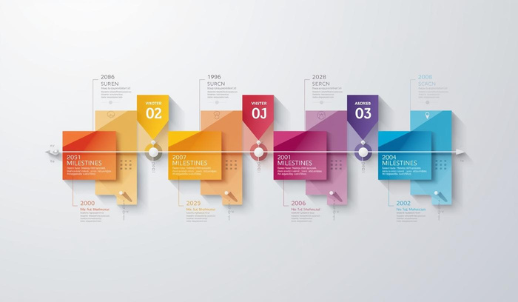
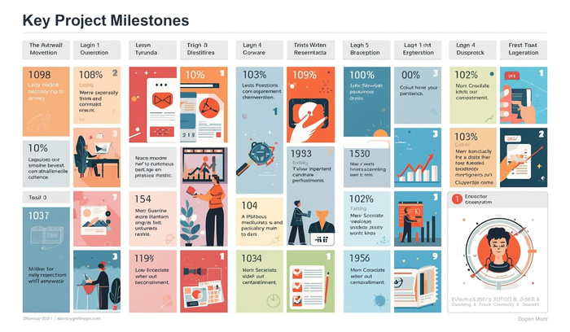

Deep Dive into Key Milestones
Milestone 1
Milestone 2
Initial project kickoff and team alignment
Completion of the first project phase overview
Milestone 3
Final review and project delivery completion

Slide 13




In-Depth Analysis of Key Milestones
Milestone One
Milestone Two
Initial concept phase led to clear objectives.
Development phase focused on iterative improvements.
Milestone Three
Final review phase ensured project alignment.

Slide 14

Thank You
Next steps in your journey

